Slide 1

Project 3: Food Sickness and its correlation with age
Michael Moore, Lara Barry, Daniel Morgan, Antoine Reed Jr., Anthony H.

Slide 2
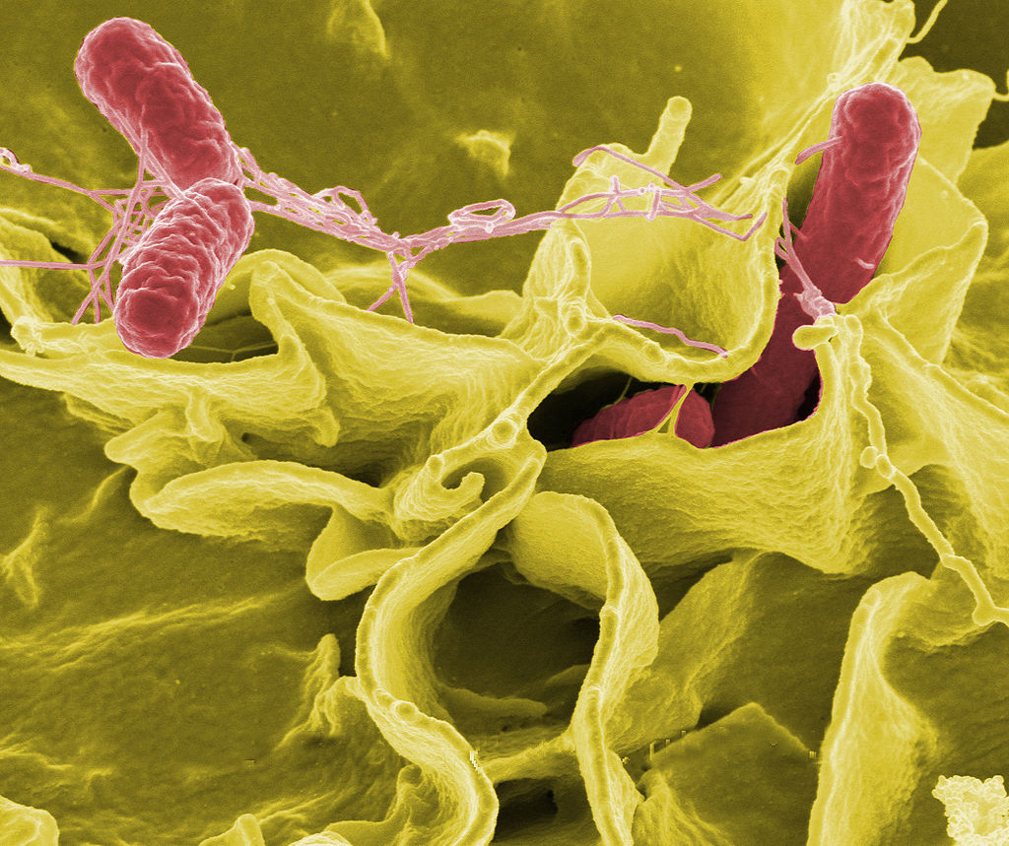
Introduction
The CDC estimates that 1 in 6 people will experience some sort of food born illness per year in the U.S.
In this presentation we will explore data obtained by FDC to find trends and patterns
This Photo by Unknown Author is licensed under CC BY-SA-NC

Slide 3
Hypothesis and Data
The data was gathered from the FDC and contains over 206,000 data points
Age-Related Hypothesis: Different age groups could show varying sensitivity to specific industry food.

